Slide 1
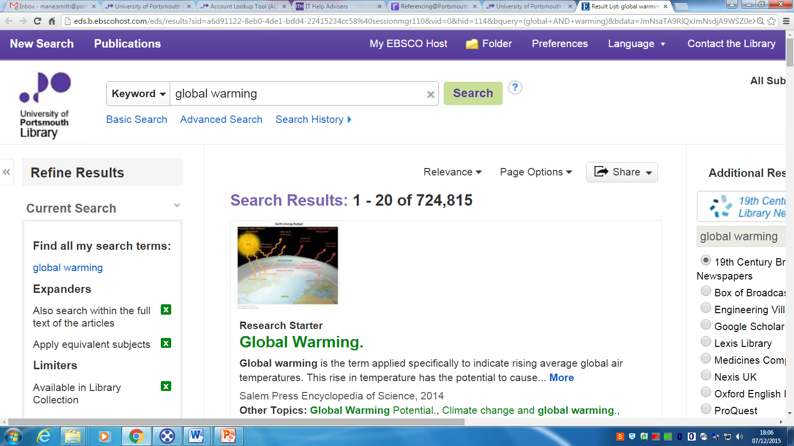
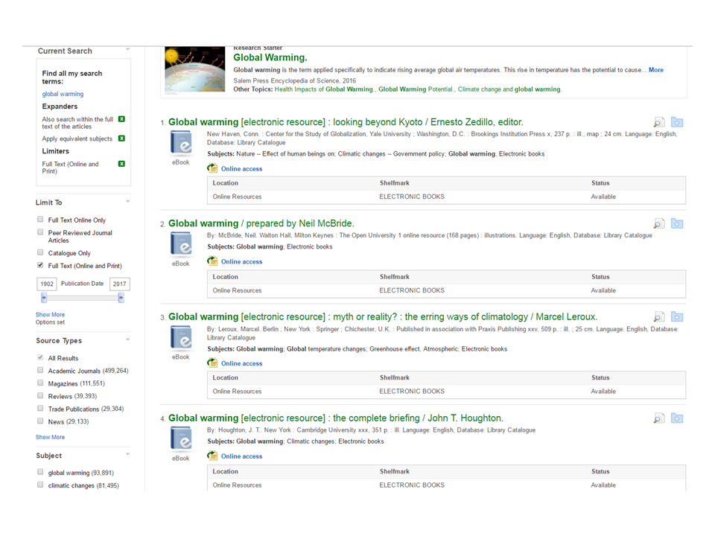

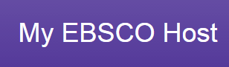

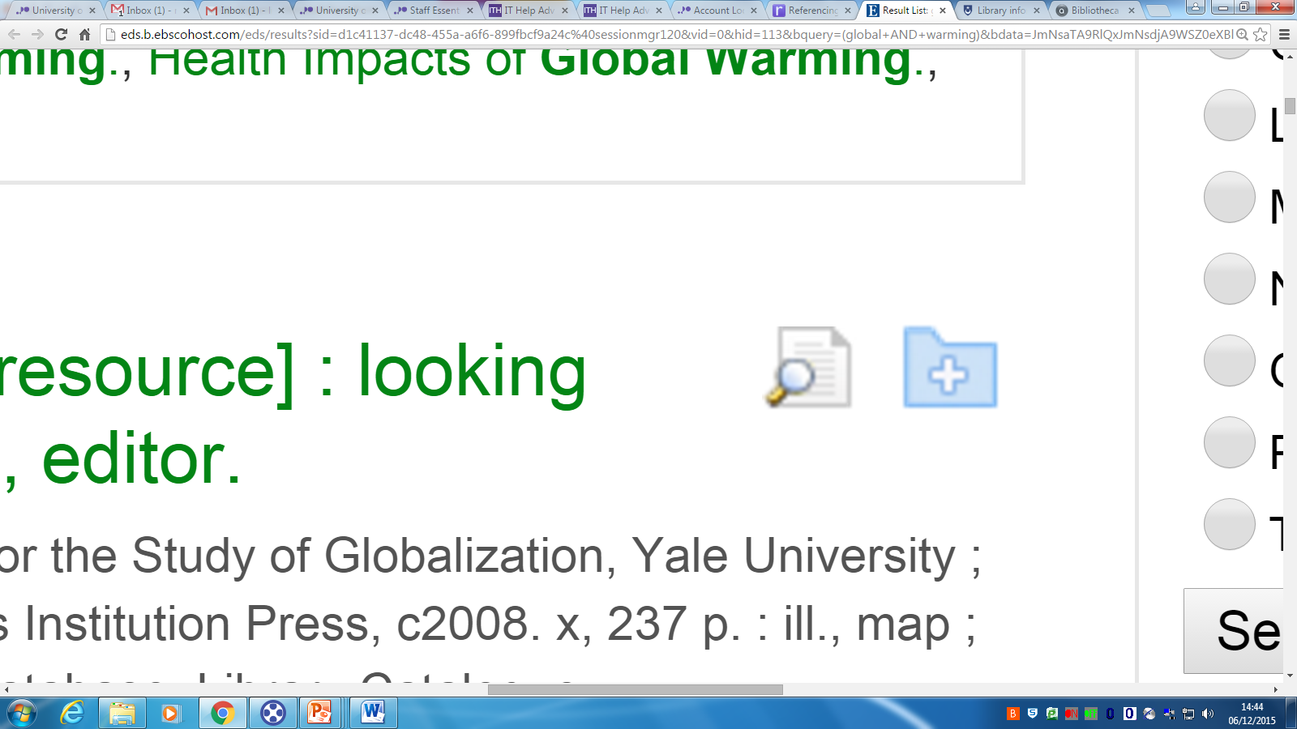

6
Discovery – Using Limiters to Refine Your Search
To keep items in folder permanently, create an account here
Click to start
6
Type your Discovery Query
5
Click to read the abstract.
If of interest, add to folder.
1
Limit by
2
1
5
3
Full Text (Online and Print) - searches both our full text online resources and our printed resources within the library.
Subject - enables you to search specifically within your original search
4
3
2
Source Types –
Book, Academic Journal etc.,
4
Publication Date – move the sliding date bar to the dates you want.
Tip: Selecting scholarly material enables you to read in depth around your topic. For more information on Source Types visit the Information Landscape

