Slide 1
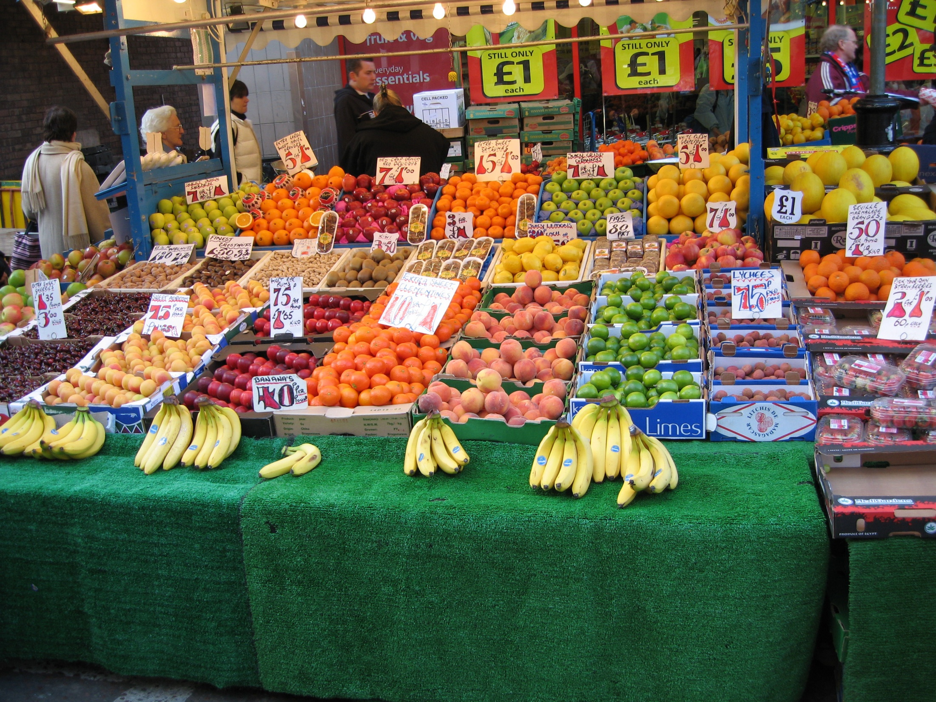
Creative Commons Licence
http://www.flickr.com/photos/rossjamesparker/89414788
Notes:
Keywords
Adam Edwards, Middlesex University
Photo from http://www.flickr.com/photos/rossjamesparker/89414788
(Creative Commons licence: use with attribution, non-commercially)
Market stall
Introductory exercise getting students to think about search terms
Prompts:
What do you see in the picture? (fruit)
Can you be more specific? (bananas, apples, melons, etc) (prices, colour, design)
* Remember to narrow your search if getting too many hits (or vice versa)
What else can you see? (people)
Who are they? (old, young, shopkeeper, customer, client, shoplifter(!))
* Think about alternative words, especially as our resources may often use US English
What is in the background? (Iceland, prices = cost, currency, pounds, therefore in UK)
What is the relationship between Iceland and the stall? (Friendly? Competitive, business rival)
Any bigger issues? (Economy, business environment; Fruit and health - 5 a day)
* Think more widely around the topic to ensure you don’t miss something relevant
Any words that might not give you what you want in a search for fruit?
* Beware of false matches: Are there any items which are also technology? (Apple, Orange, Apricot? Raspberry PI) - some words need combining with others so you don’t get false matches.
And now let’s look at a real project and do the same thinking….

Slide 2

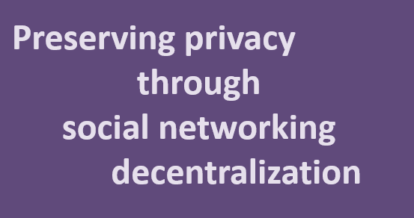
Outsourcing
technical help
to call-centres
Development of an electric bicycle for urban transportation
Risk assessment of OSH factors in the building industry in Lithuania
The design and implementation of a wireless car security system in the United Kingdom
Power management systems for wind turbines in Cornwall

Slide 3


Slide 4
labour / labor
migrant
foreign
workforce
building

Slide 5
culture
labour / labor
migrant
foreign
workforce
behavior
building
U.K.
United Kingdom
GB / G.B. / Great Britain
“construction industry”
“building industry”

Slide 6
challenges
Intervention
strategy
culture
labour / labor
migrant
foreign
workforce
behavior
building
U.K.
United Kingdom
GB / G.B. / Great Britain
“construction industry”
“building industry”
law
case studies
London / Birmingham / Glasgow

Slide 7
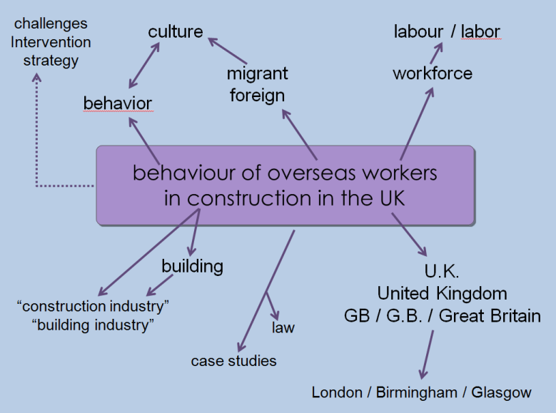
Think about the keywords you use in the Library Catalogue, in database searching, or in Google/Google Scholar
Alternative words – lift/elevator; colour/color
Note tips such as truncation: build* will search (in most databases but not Google) for build, building, buildings etc.
Watch out for punctuation such as hyphens which Google ignores but many databases treat as a separate search
Use “ “ to search for phrases “construction industry”
Related keywords: overseas, migrant, foreign
If you’re finding too much, narrow down your search
If you’re finding too little, broaden your search out

Slide 9
Outsourcing
technical help
to call-centres

Slide 10
Outsourcing
technical help
to call-centres
help desk
online help
help lines
telephone support
telephone hotlines
call-centers

Slide 11
Outsourcing
technical help
to call-centres
help desk
outsourcing
out-sourcing
online help
help lines
telephone support
telephone hotlines
call-centers
costs
UK
India
comparison

Slide 12
Outsourcing
technical help
to call-centres
contracting out
help desk
outsourcing
out-sourcing
online help
help lines
telephone support
telephone hotlines
technical support
call-centers
costs
UK
India
U.K.
United Kingdom
comparison
England

Slide 13
information technnology
telecommunications networks
IT or I.T.
web-based
Outsourcing
technical help
to call-centres
contracting out
help desk
outsourcing
out-sourcing
online help
help lines
telephone support
telephone hotlines
technical support
call-centers
costs
UK
India
U.K.
United Kingdom
comparison
England

Slide 14
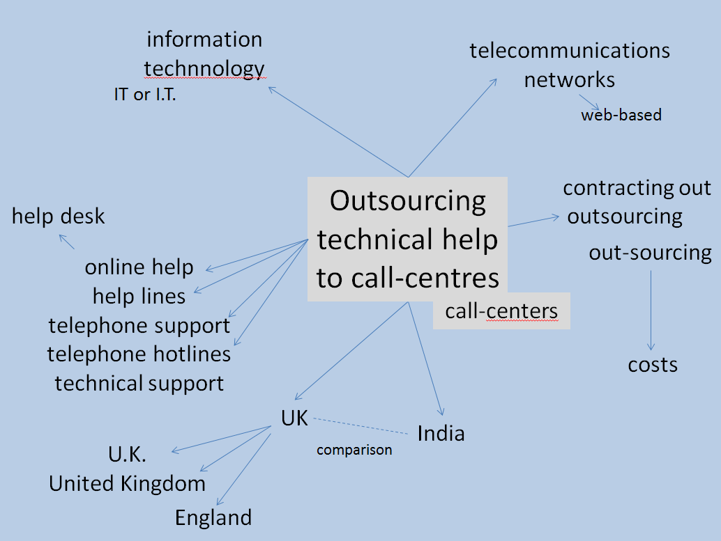
Think about the keywords you use in the Library Catalogue, in database searching, or in Google/Google Scholar
Alternative words – lift/elevator; colour/color
Note tips such as truncation: outsourc* will search (in most databases but not Google) for outsource, outsourced, outsourcing etc.
Watch out for punctuation such as hyphens which Google ignores but many databases treat as a separate search
Use “ “ to search for phrases “information technology”
Related keywords: online help, technical support, help lines
If you’re finding too much, narrow down your search
If you’re finding too little, broaden your search out

Slide 16
Risk assessment of OSH factors in the building industry in Lithuania

Slide 17
occupational safety and health
chronological
risk assessment
Risk assessment of OSH factors in the building industry in Lithuania
geographical
construction
Lithuania*

Slide 18
health and safety
health & safety
occupational safety & health
OSH
risks
occupational safety and health
risk management
chronological
risk assessment
Risk assessment of OSH factors in the building industry in Lithuania
geographical
construction
Lithuania*
“construction sector”
“building sector”
civil engineering

Slide 19
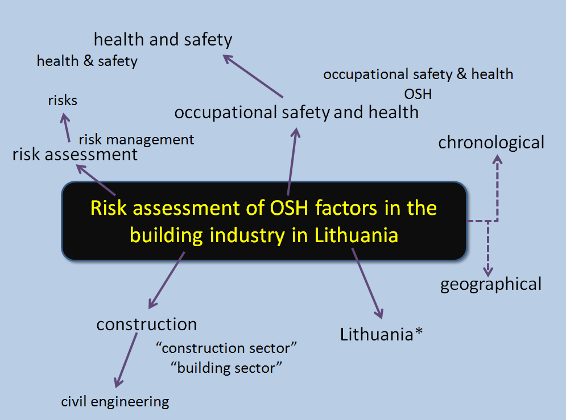
Think about the keywords you use in the Library Catalogue, in database searching, or in Google/Google Scholar
Alternative words – lift/elevator; colour/color
Note tips such as truncation: outsourc* will search (in most databases but not Google) for outsource, outsourced, outsourcing etc.
Watch out for punctuation such as hyphens which Google ignores but many databases treat as a separate search
Use “ ” to search for phrases “health and safety”
Related keywords: construction, building, civil engineering
If you’re finding too much, narrow down your search
If you’re finding too little, broaden your search out

Slide 21
Preserving privacy through
social networking decentralization

Slide 22
Preserving privacy through
social networking decentralization
decentralisation
peer-to-peer computing
peer-to-peer networks
P2P

Slide 23
Preserving privacy through
social networking decentralization
social media
online interaction
SNS
S.N.S.
social network services
decentralisation
peer-to-peer computing
peer-to-peer networks
P2P

Slide 24
personal information
trust issues
data handling
data privacy
data security
security
anonymity
“security of data”
Preserving privacy through
social networking decentralization
social media
online interaction
SNS
S.N.S.
social network services
decentralisation
peer-to-peer computing
peer-to-peer networks
P2P

Slide 25
personal information
trust issues
data handling
data privacy
data security
security
anonymity
“security of data”
Preserving privacy through
social networking decentralization
social media
online interaction
SNS
S.N.S.
social network services
decentralisation
FaceBook
Twitter
LinkedIn
peer-to-peer computing
peer-to-peer networks
P2P

Slide 26
personal information
trust issues
software architecture
data handling
data privacy
data security
security
internet applications
anonymity
“security of data”
Preserving privacy through
social networking decentralization
social media
online interaction
SNS
S.N.S.
social network services
decentralisation
FaceBook
Twitter
LinkedIn
peer-to-peer computing
peer-to-peer networks
P2P

Slide 27
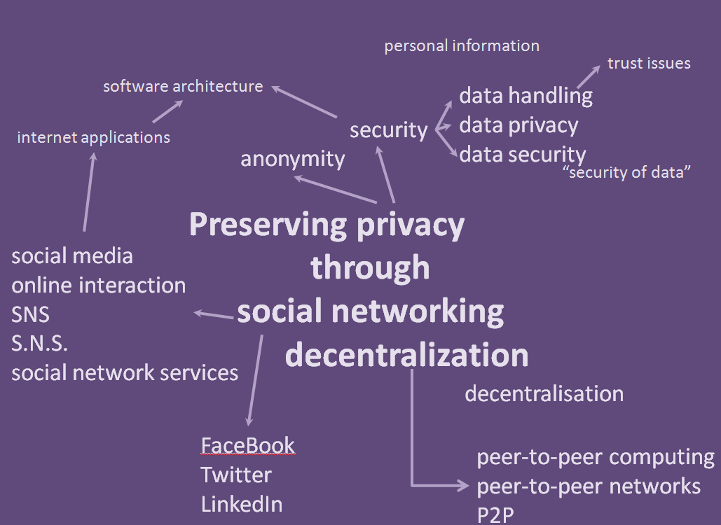
Think about the keywords you use in the Library Catalogue, in database searching, or in Google/Google Scholar
Alternative words – lift/elevator; colour/color
Note tips such as truncation: comput* will search (in most databases but not Google) for computer, computers, computing etc.
Watch out for punctuation such as hyphens which Google ignores but many databases treat as a separate search
Use “ “ to search for phrases “peer-to-peer computing”
Related keywords: social media, social network
If you’re finding too much, narrow down your search
If you’re finding too little, broaden your search out

Slide 29
Power management systems for wind turbines in Cornwall

Slide 30
energy management
Power management systems for wind turbines in Cornwall
“south west England”
wind farms
or c.f. Aberdeenshire etc
windfarms

Slide 31
energy management
Power management systems for wind turbines in Cornwall
reactive power management
active load management
demand management
renewable energy
marine renewable energy
“south west England”
wind farms
offshore
or c.f. Aberdeenshire etc
windfarms
marine energy

Slide 32
smart grid
artificial neural networks
ICCM / I.C.C.M.
smart appliances
integration, control, communication and metering
energy management
Power management systems for wind turbines in Cornwall
reactive power management
active load management
demand management
renewable energy
marine renewable energy
“south west England”
wind farms
offshore
or c.f. Aberdeenshire etc
windfarms
marine energy

Slide 33
smart grid
artificial neural networks
ICCM / I.C.C.M.
smart appliances
integration, control, communication and metering
energy management
environmental
Power management systems for wind turbines in Cornwall
reactive power management
active load management
demand management
geographical
renewable energy
marine renewable energy
“south west England”
wind farms
offshore
or c.f. Aberdeenshire etc
windfarms
marine energy

Slide 34
smart grid
sustainability
artificial neural networks
environmental impact
energy policy
ICCM / I.C.C.M.
smart appliances
integration, control, communication and metering
energy management
environmental
Power management systems for wind turbines in Cornwall
reactive power management
active load management
demand management
geographical
renewable energy
marine renewable energy
“south west England”
wind farms
offshore
or c.f. Aberdeenshire etc
windfarms
marine energy

Slide 35
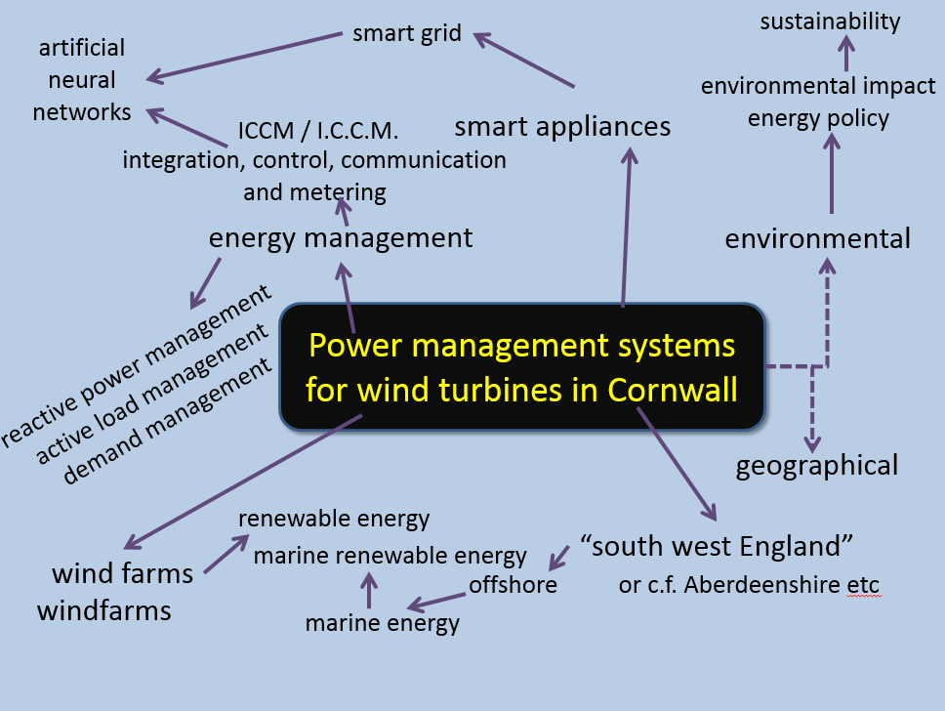
Think about the keywords you use in the Library Catalogue, in database searching, or in Google/Google Scholar
Alternative words – lift/elevator; colour/color
Note tips such as truncation: energ* will search (in most databases but not Google) for energy, energies, energetic etc.
Watch out for punctuation such as hyphens which Google ignores but many databases treat as a separate search
Use “ “ to search for phrases “renewable energy”
Related keywords: smart grid, smart appliances
If you’re finding too much, narrow down your search
If you’re finding too little, broaden your search out

Slide 37
The design and implementation of a wireless car security system in the United Kingdom

Slide 38
Bluetooth
RFID
product design
The design and implementation of a wireless car security system in the United Kingdom
automobile*
“alarm system”

Slide 39
communication
Bluetooth
RFID
innovation
CAD
product design
Radio Frequency Identification
The design and implementation of a wireless car security system in the United Kingdom
UK
automobile*
U.K.
“alarm system”

Slide 40
communication
human factors
Bluetooth
RFID
innovation
CAD
product design
Radio Frequency Identification
The design and implementation of a wireless car security system in the United Kingdom
vehicle
software engineering
security architecture
UK
automobile*
U.K.
“alarm system”
England / Scotland …

Slide 41
communication
human factors
Bluetooth
RFID
manufacture
innovation
CAD
product design
Radio Frequency Identification
legal issues
legislation
crime
The design and implementation of a wireless car security system in the United Kingdom
vehicle
software engineering
security architecture
UK
automobile*
U.K.
“alarm system”
England / Scotland …

Slide 42
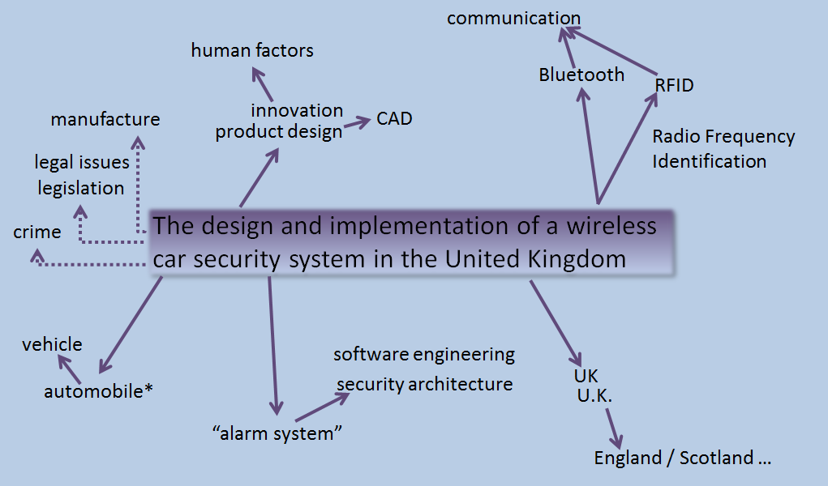
Think about the keywords you use in the Library Catalogue, in database searching, or in Google/Google Scholar
Alternative words – lift/elevator; colour/color
Note tips such as truncation: automobile* will search (in most databases but not Google) for automobile, automobiles etc.
Watch out for punctuation such as hyphens which Google ignores but many databases treat as a separate search
Use “ “ to search for phrases “security system”
Related keywords: “security system”, “alarm system” “car alarm”
If you’re finding too much, narrow down your search
If you’re finding too little, broaden your search out

Slide 44
Development of an electric bicycle for urban transportation
Notes:
In groups of 2 or 3 think about what keywords you might use to search for resources to use for this assignment.
If you’ve got access to a mobile device you can use Discovery (or other databases) to give you ideas for other keywords – many papers have them assigned by the database, the journal or the author.

Slide 45
“electric bicycle”
“electric bike”
Development of an electric bicycle for urban transportation
batter*
electric motor
electric drives
Notes:
No right or wrong answer, but these are some of the things I came up with.
Electric bicycle might be electric bike… using quotes searches for the exact expression
battery, batteries might both be of interest, truncating and using the * (in most databases but not Google) will allow you to search for all variations in one go. Be careful about truncating too early however.

Slide 46
electric motorbike*
“electric bicycle”
“electric bike”
scooter*
e-bike
Development of an electric bicycle for urban transportation
transport
infrastructure
batter*
electric motor
electric drives
city OR cities
“urban areas”
Notes:
Electric bicycles might lead us on to thinking about e-bike or e-bikes or even electric motorcycles or motorbikes or scooter*
Urban might suggest city or cities or “urban areas” which will give different – but possibly still relevant - results

Slide 47
electric vehicle*
electric power assisted bicycles
electric motorbike*
“electric bicycle”
“electric bike”
regulations
scooter*
e-bike
marketing
Development of an electric bicycle for urban transportation
health and safety
energy
transport
infrastructure
batter*
electric motor
electric drives
environment
sustainability
city OR cities
“urban areas”
electromechanical systems
Notes:
You might start to think about related areas such as regulations or marketing or health & safety – you might have particular interests that encourage you to explore in specific avenues.
This shouldn’t be a fixed or finished list or diagram, but will develop as you explore the topic and find new sources of information and develop your understanding and vocabulary.

Slide 48
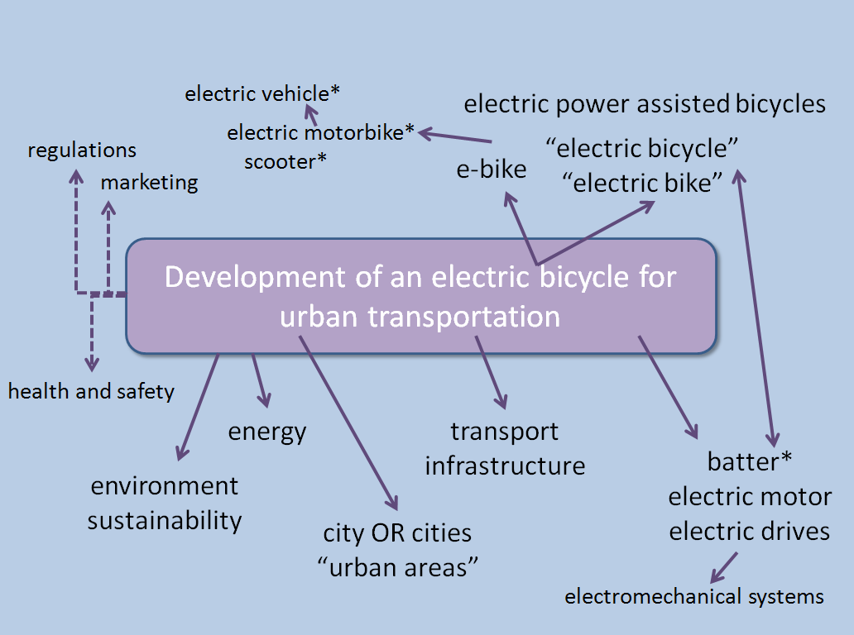
Think about the keywords you use in the Library Catalogue, in database searching, or in Google/Google Scholar
Alternative words – lift/elevator; colour/color
Note tips such as truncation: build* will search (in most databases but not Google) for build, building, buildings etc.
Watch out for punctuation such as hyphens which Google ignores but many databases treat as a separate search
Use “ “ to search for phrases, e.g. “product design”
Related keywords: electric, battery
If you’re finding too much, narrow down your search
If you’re finding too little, broaden your search out

Slide 50
Structural performance of fibre reinforced concrete in UK housing

Slide 51
tests
Structural performance of fibre reinforced concrete in UK housing
fibre-reinforced
fiber reinforced
fiber-reinforced
building materials
United Kingdom
U.K.
England, Scotland…

Slide 52
tests
Structural performance of fibre reinforced concrete in UK housing
fibre-reinforced
fiber reinforced
fiber-reinforced
re-inforced
building materials
United Kingdom
U.K.
England, Scotland…

Slide 53
fibre reinforced composites
reinforced concrete
tests
standards
Structural performance of fibre reinforced concrete in UK housing
fibre-reinforced
fiber reinforced
fiber-reinforced
re-inforced
building materials
United Kingdom
U.K.
England, Scotland…

Slide 54
strength of materials
materials property
fibre reinforced composites
reinforced concrete
tests
standards
Structural performance of fibre reinforced concrete in UK housing
fibre-reinforced
fiber reinforced
fiber-reinforced
re-inforced
building materials
concrete beams
United Kingdom
U.K.
England, Scotland…
concrete cracking

Slide 55
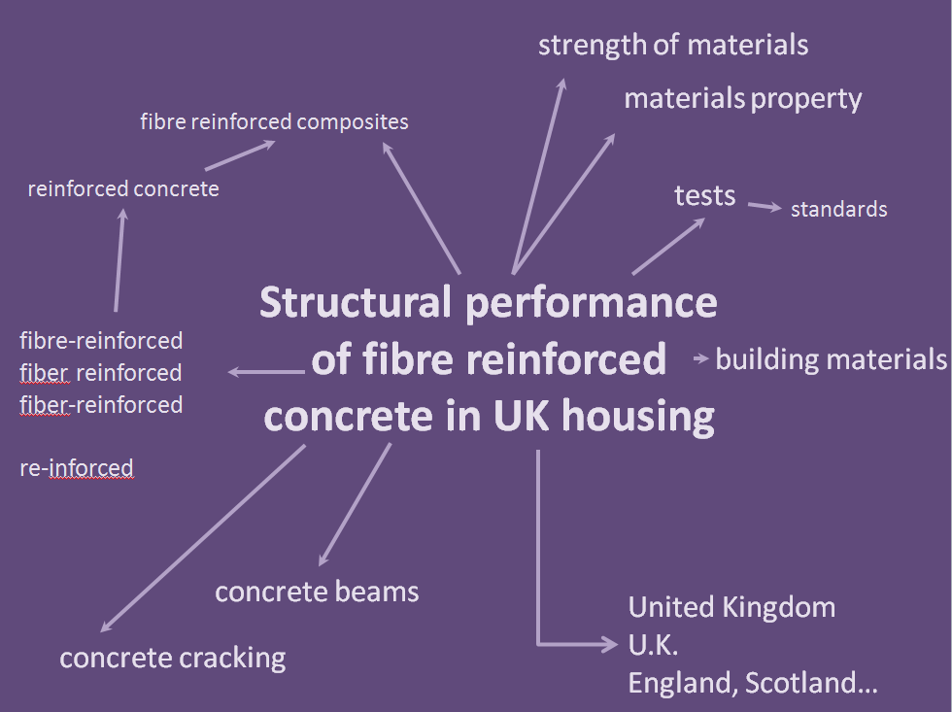
Think about the keywords you use in the Library Catalogue, in database searching, or in Google/Google Scholar
Alternative words – lift/elevator; colour/color
Note tips such as truncation: hous* will search (in most databases but not Google) for house, houses, housing etc.
Watch out for punctuation such as hyphens which Google ignores but many databases treat as a separate search
Use “ “ to search for phrases “fibre reinforced concrete”
Related keywords: standards, regulations, legal framework
If you’re finding too much, narrow down your search
If you’re finding too little, broaden your search out

Slide 57
Risk assessment of OSH factors in the building industry in Lithuania

Slide 58
occupational safety and health
chronological
risk assessment
Risk assessment of OSH factors in the building industry in Lithuania
geographical
construction
Lithuania*

Slide 59
health and safety
health & safety
occupational safety & health
OSH
risks
occupational safety and health
risk management
chronological
risk assessment
Risk assessment of OSH factors in the building industry in Lithuania
geographical
construction
Lithuania*
“construction sector”
“building sector”
civil engineering

Slide 60
Think about the keywords you use in the Library Catalogue, in database searching, or in Google/Google Scholar
Alternative words – lift/elevator; colour/color
Note tips such as truncation: outsourc* will search (in most databases but not Google) for outsource, outsourced, outsourcing etc.
Watch out for punctuation such as hyphens which Google ignores but many databases treat as a separate search
Use “ ” to search for phrases “health and safety”
Related keywords: construction, building, civil engineering
If you’re finding too much, narrow down your search
If you’re finding too little, broaden your search out

Slide 62

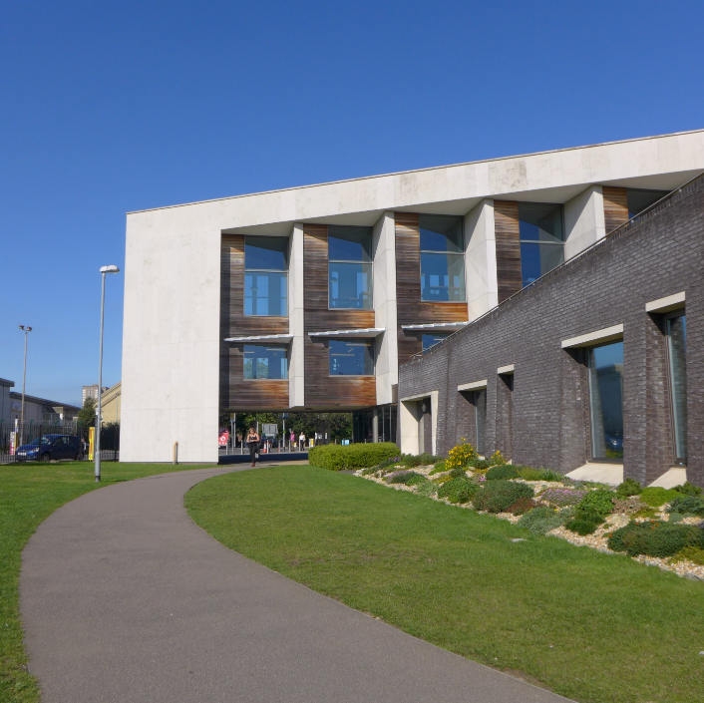






JOIN US ONLINE
@uoplibrary

