Slide 1
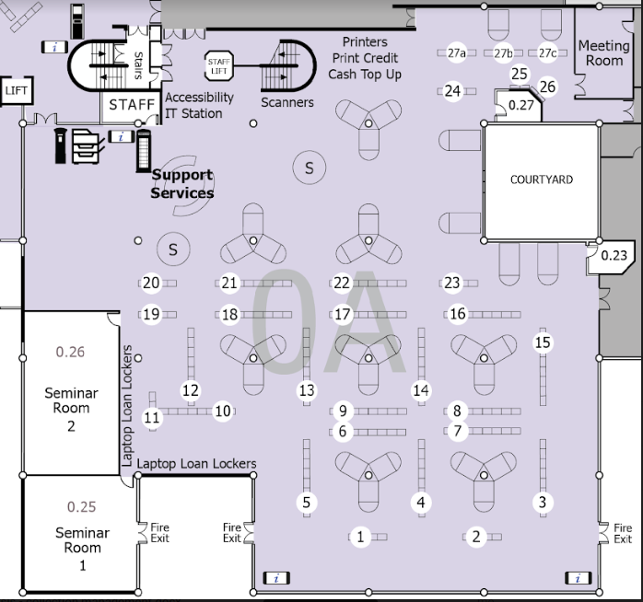

Ground Floor
Find your books
Block | Shelf Numbers |  |  | Block | Shelf Numbers
1 | 001 | - | 004.21 | 15 | 301.01 | - | 302.222
2 | 004.21 | - | 004.6780835 | 16 | 302.222 | - | 302.3
3 | 004.6782 | - | 005.4476 | 17 | 302.3 | - | 303.4
4 | 005.4476 | - | 006.696 | 18 | 303.4823 | - | 303.6230954
5 | 006.696 | - | 070.194 | 19 | 303.625 | - | 304.6021
6 | 070.195 | - | 128.2 | 20 | 304.6021 | - | 305.231
7 | 128.2 | - | 150.1952 | 21 | 305.231 | - | 305.4098
8 | 150.1952 | - | 153 | 22 | 305.4098 | - | 305.56309426
9 | 153 | - | 155.2 | 23 | 305.563043 | - | 305.80941
10 | 155.2 | - | 155.646 | 24 | 305.80941 | - | 306 BEL
11 | 155.646 | - | 158.2403 | 25 | 306 BEN | - | 306 GRE
12 | 158.26 | - | 193 | 26 | 306 GRI | - | 306 MEN
13 | 193 | - | 300.15 | 27 | 306 MER | - | 306.44999
14 | 300.15 | - | 301.01
MAY,2024

Slide 2
Find your books
Shelf Numbers |  |  | Floor
001 | – | 099 | Ground
100 | – | 199 | Ground
200 | – | 306.44999 | Ground
306.45 | – | 351.99 | First (1C)
352 | – | 399 | First (1A)
400 | – | 499 | First (1A)
500 | – | 599 | First (1A)
600 | – | 699 | First (1A)
700 | – | 799 | First (1B)
800 | – | 809 | First (1B)
810 | – | 899 | Second (2B)
900 | – | 999 | Second (2B)
Glass Cupboard Collection OIW Collection |  |  | Atrium – Ground
Large Book Collection |  |  | Second (2B) At the end of the main sequence
Pamphlets |  |  | Second (2B) At the end of the main sequence
MAY,2024

